Slide 1
Team 2 - Create a script that redirects the output of a command to a file. Allow the user to specify the filename as an argument. Ensure the script checks for existing files and prompts the user for confirmation before overwriting
Team Members -
Arnav Aggarwal(RA2111032010002)
Shaurya Singh Srinet(RA2111032010006)
Ronit Kumar(RA2111032010009)
Parth Galhotra(RA2111032010029)
Kanak Shilledar(RA2111032010060)

Slide 2
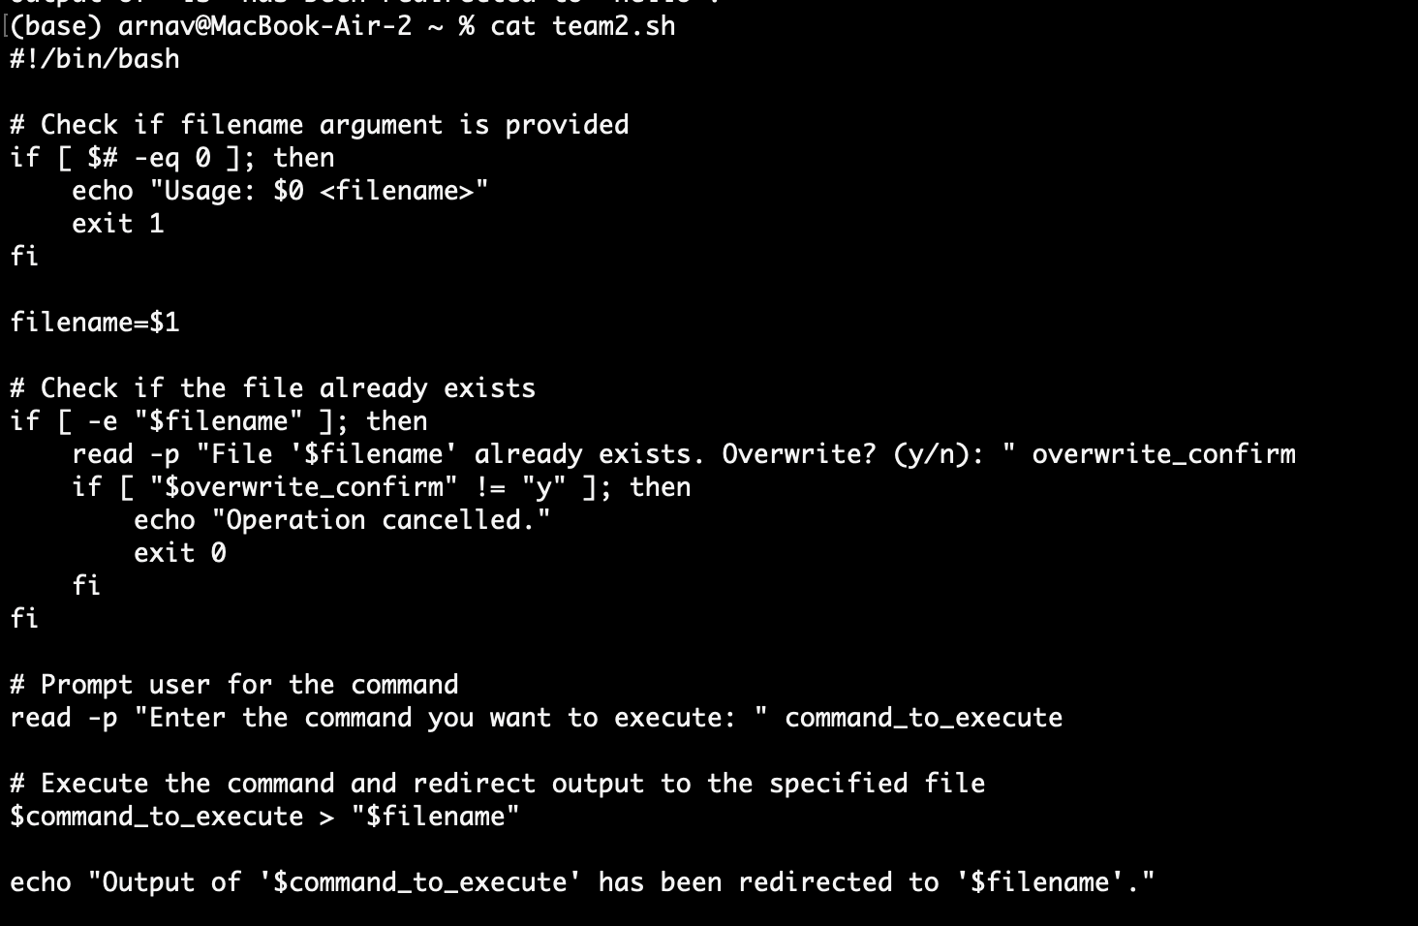
Problem Execution

Slide 3
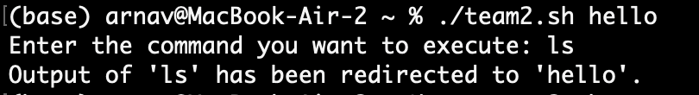
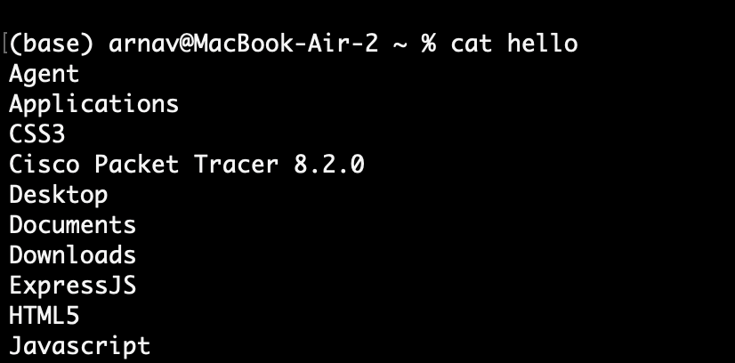
Output

